Slide 1
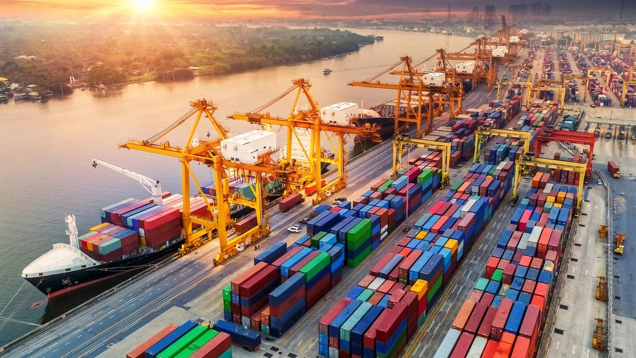
WELCOME TO KUALA LUMPUR

Slide 2
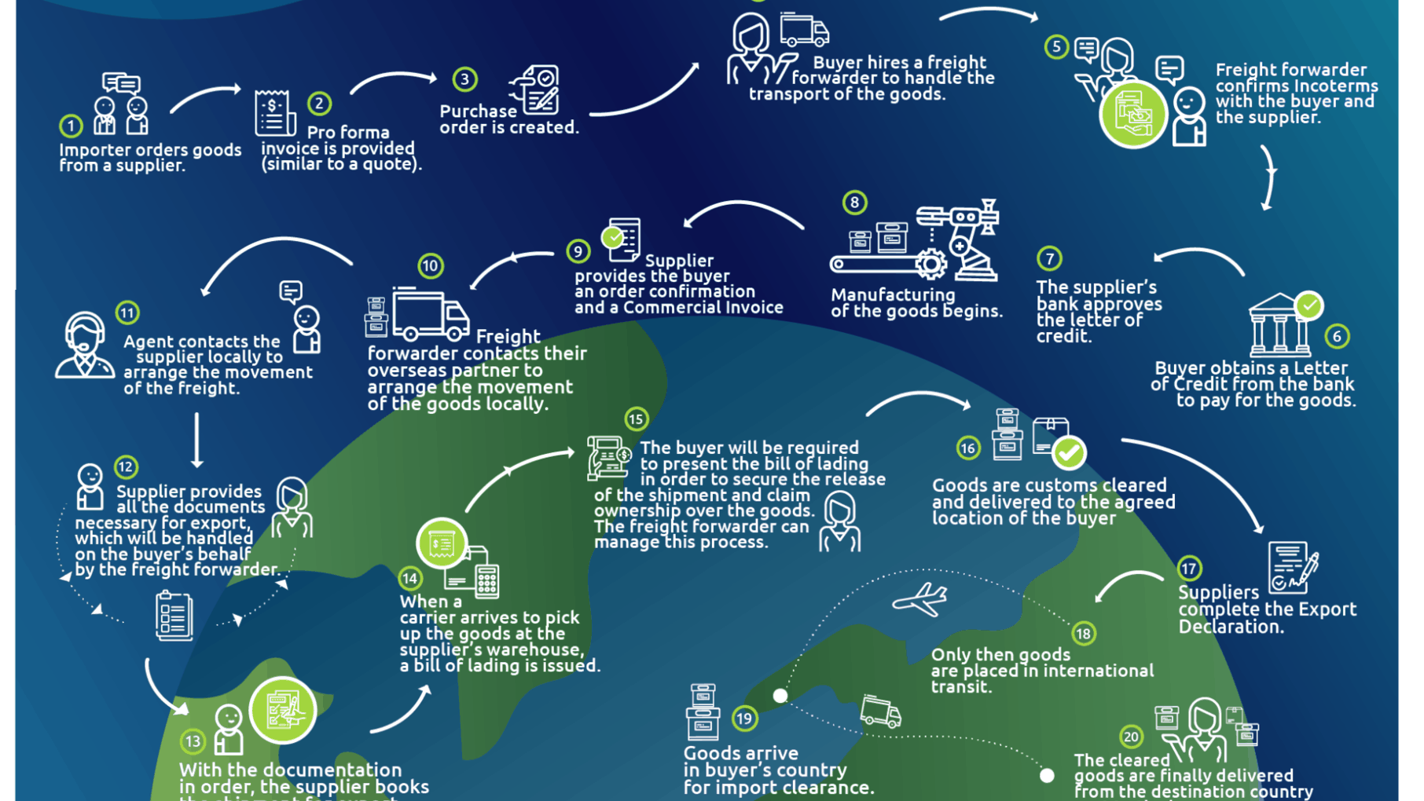

Slide 3
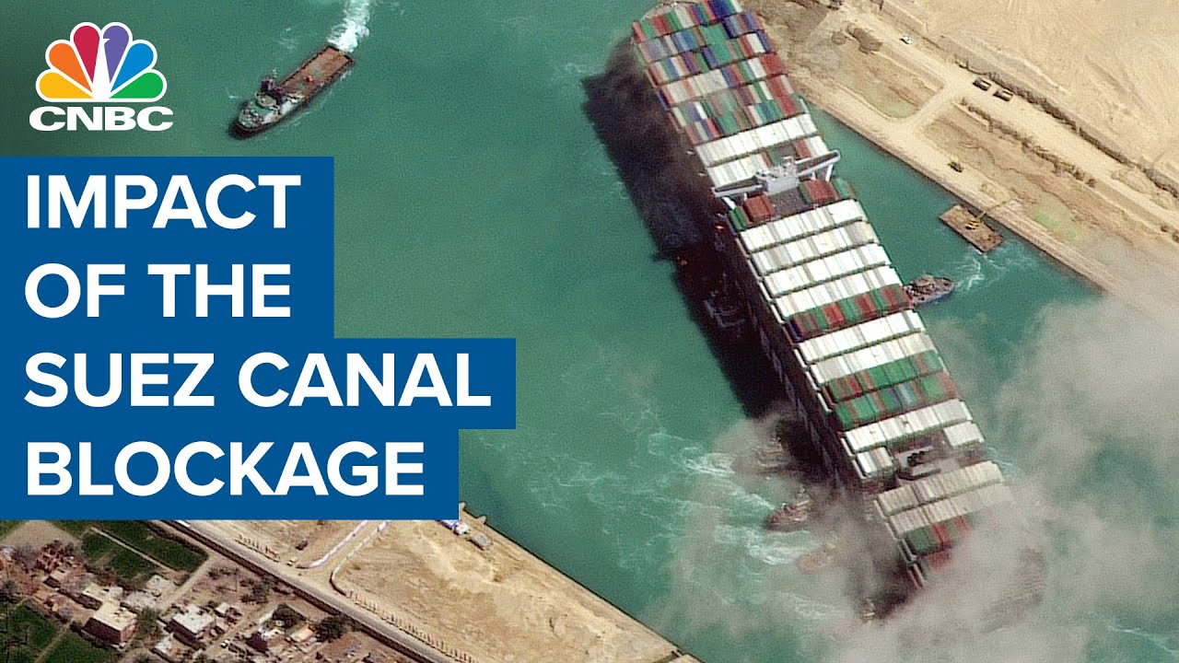

Slide 4






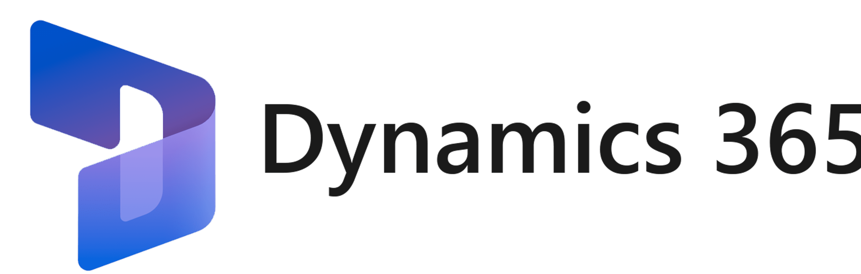






THE SAAS ERA

Slide 5


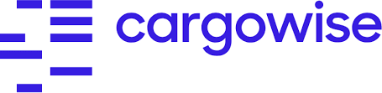
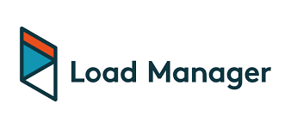









THE SAAS ERA

Slide 6
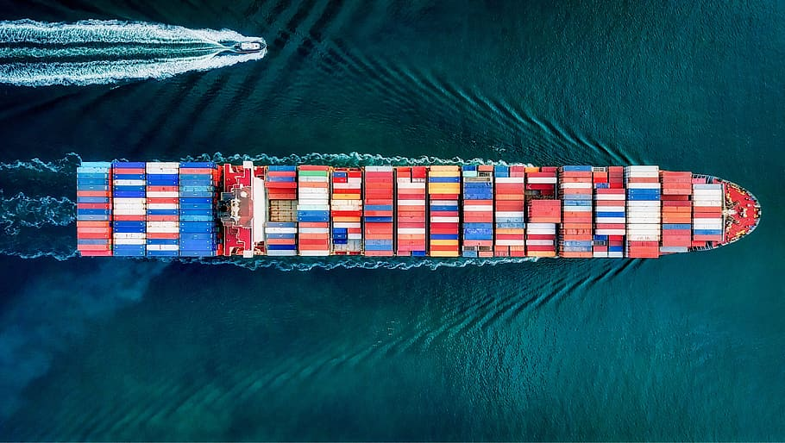
“You may end up with a great website or mobile app, but you have learnt nothing in the process and have not taken ownership of your digital strategy.”
- Anonymous
TAKE OWNERSHIP

Slide 7
WHAT IT TAKES?
TECHNOLOGY
PEOPLE
METHODOLOGY

Slide 8
THE RIGHT TEAM

Slide 9
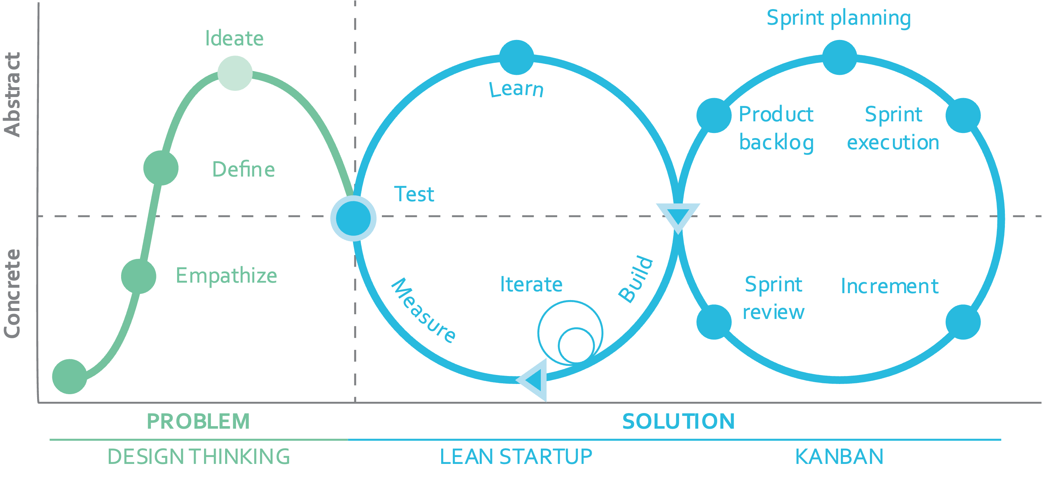
A COMBINATION OF DESIGN THINKING, LEAN AND AGILE

Slide 10
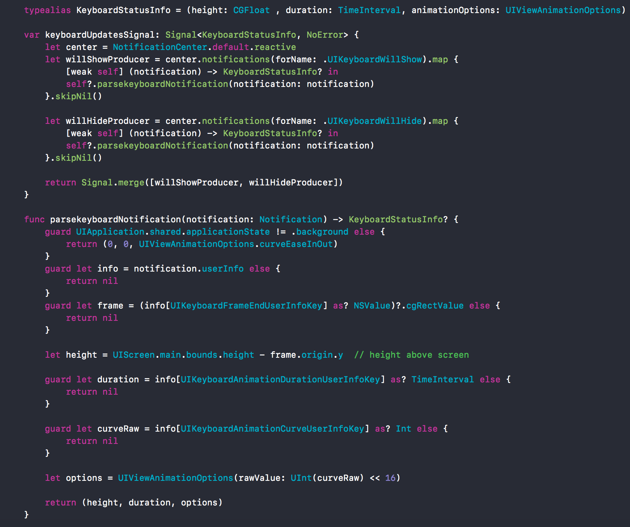
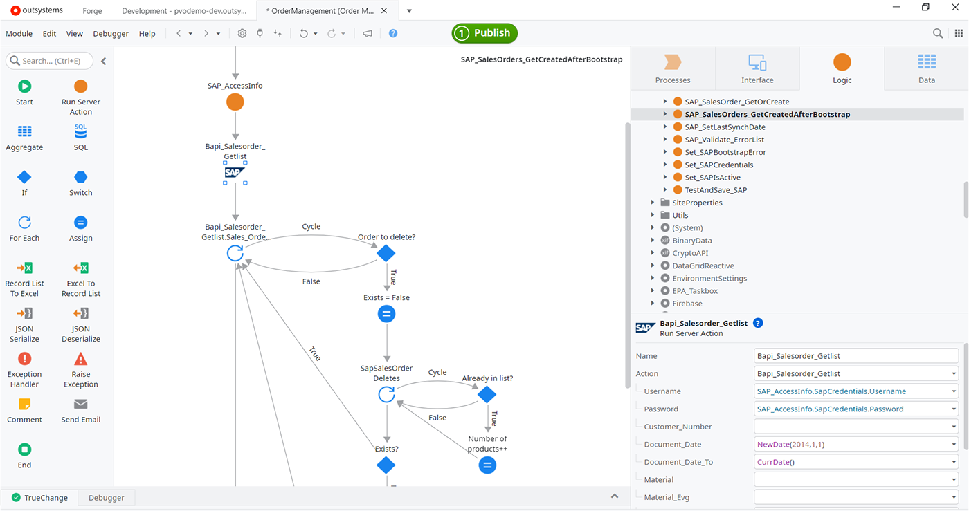
LOW-CODE IS AN OPTION

Slide 11
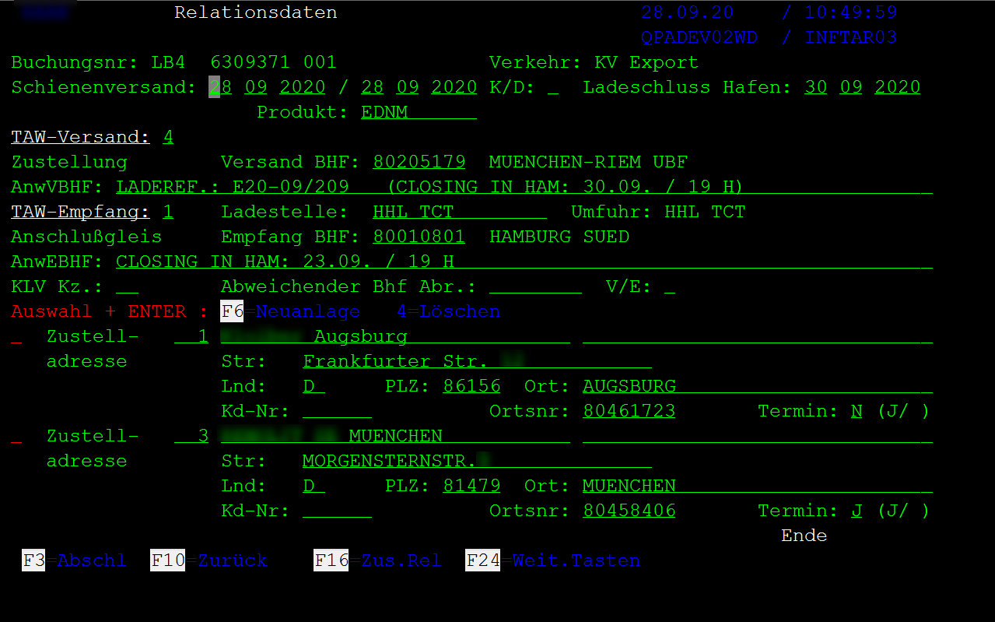
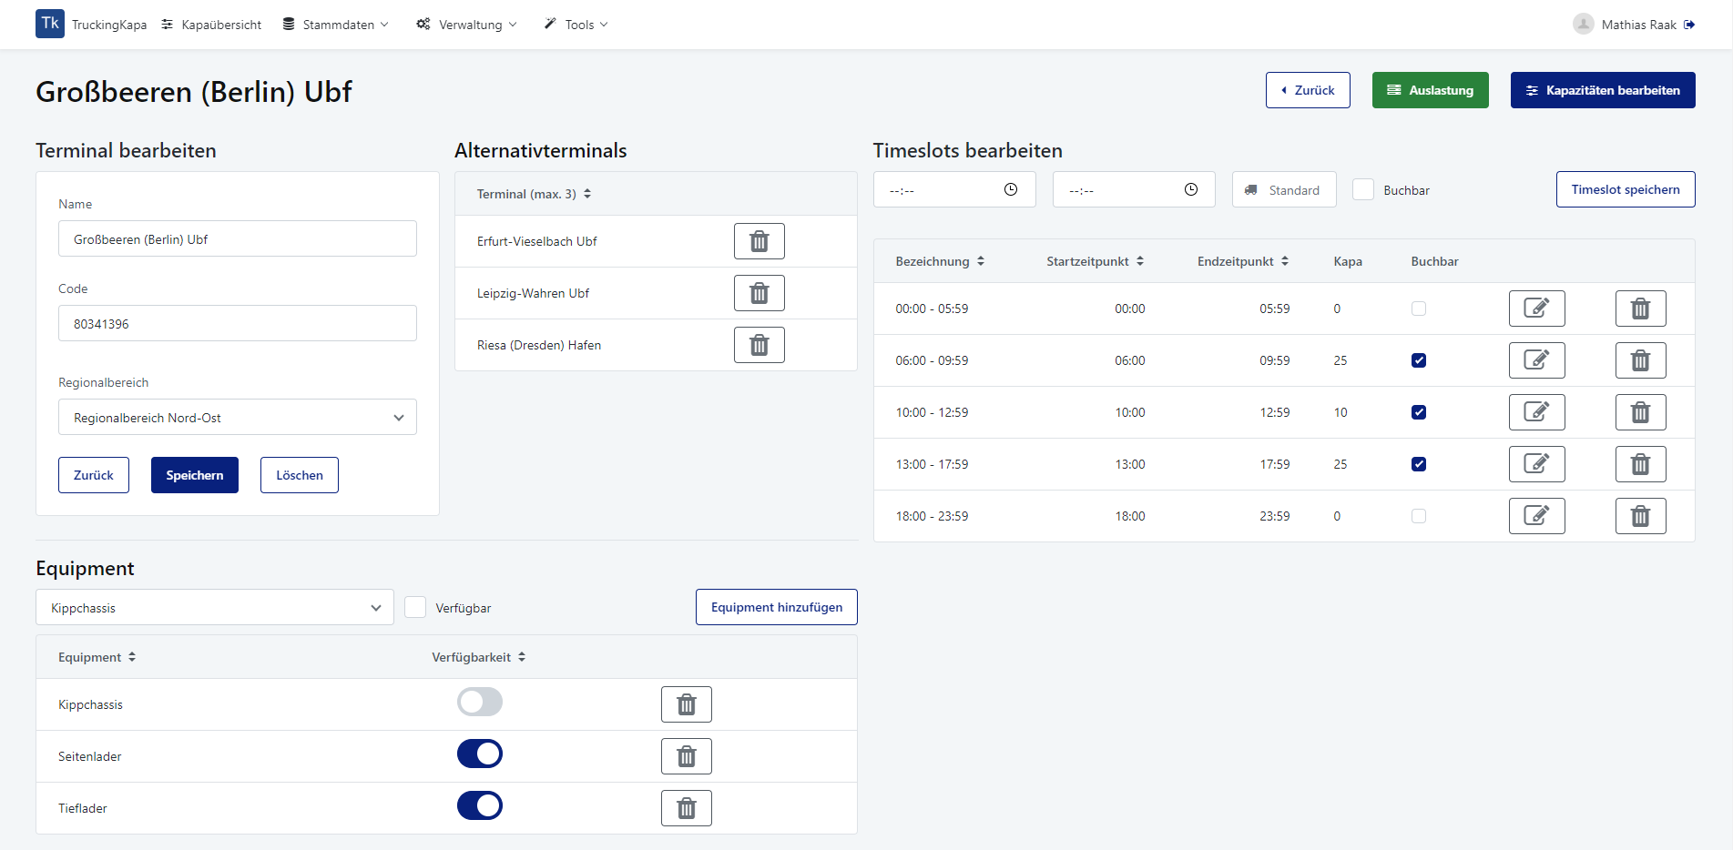
LOW-CODE IS AN OPTION

Slide 12
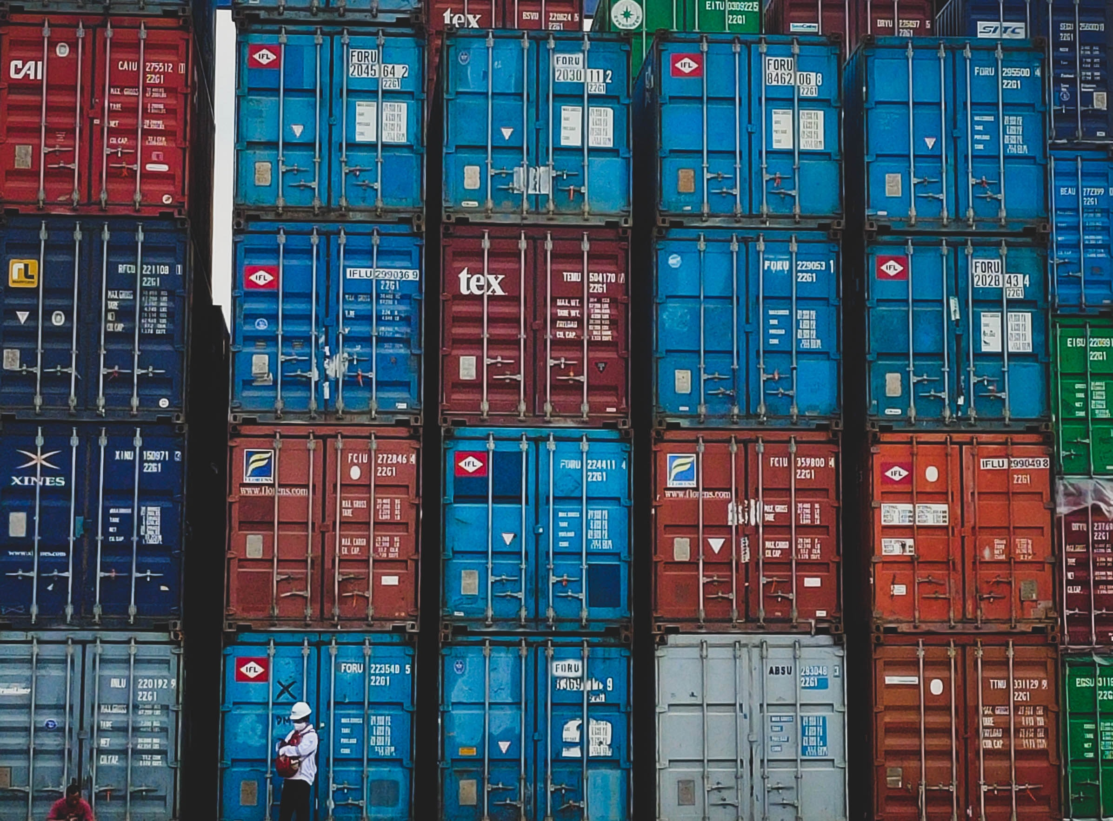
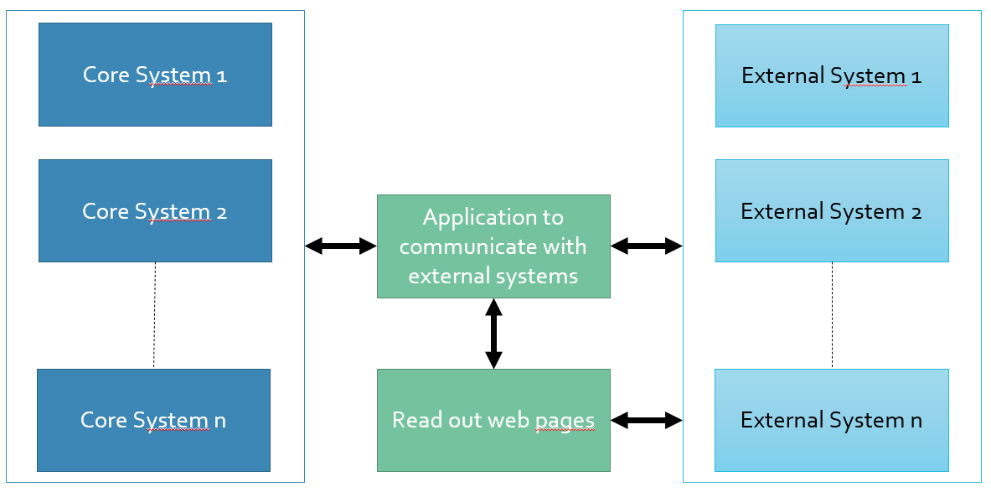
Connection to external systems
Solution:
Development of a separate application to communicate with the external systems
Standardized interface to the core systems
Flexible possibilities to connect new interfaces without the need to intervene in the core applications
Reading of data from a web page via additional solution in a fixed time interval
Problem description:
Multiple and unique third-party systems for suppliers and partners
  With EDI to connect
  Only one website
Data and updates are to be imported fully automatically, securely and as promptly as possible
Complex and time-consuming to connect new subsystems

Slide 13
Disposition in case of delays
Problem description:
Changed arrival times at the port are detected too late
Late notification of train delays
Too late rescheduling of transport services with trucks and trains
Increased stress for dispatchers due to delayed information
Client’s satisfaction with lack of communication of transport changes
Solution:
Read-out of arrival times via the ports' website
Connection to EDIs for reading out the travel data of trains
Automatic information for dispatchers in case of delays
Proposal for alternative transport schedule
Automatic communication towards clients

Slide 14
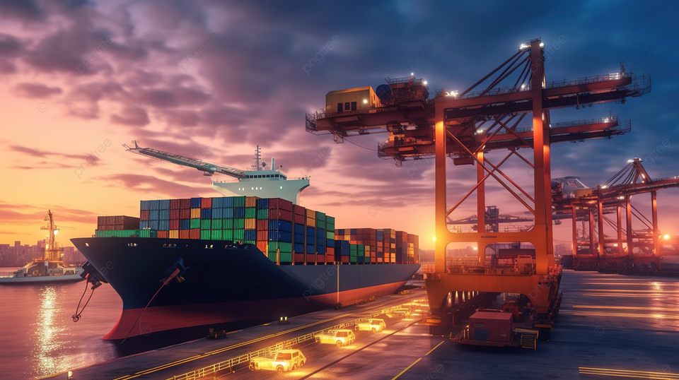
THANK YOU

