Slide 1


Drewry Container Market Outlook 2024
  What it means to Freight Forwarding?
    Presented by Vincent Chew
    chew@drewry.co.uk
16 November 2023

Slide 2
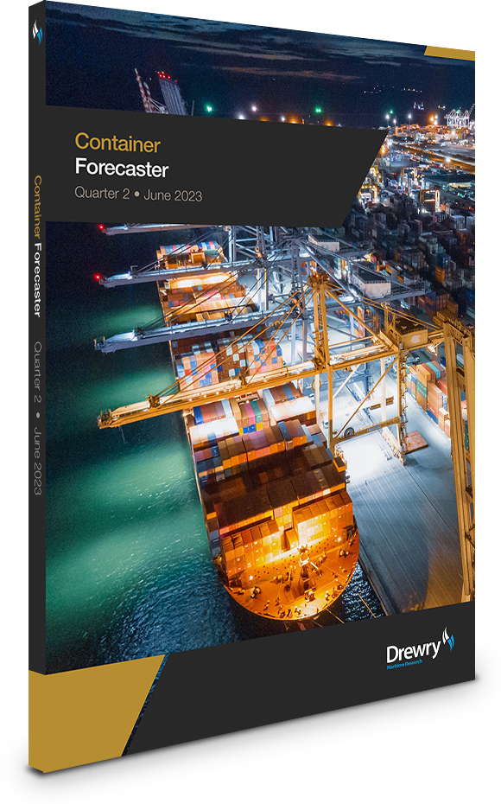
Principal source material for this presentation
Drewry Container Forecaster (updated monthly & quarterly)
Regular and timely analysis of the sector
  World container trade and regional port volumes forecasts
  Global supply and demand outlook
  Trade route supply and demand analysis
  Global and East-West trade freight rate forecasts
  Carrier profitability analysis
  Charter market and sales & purchases
Complementary access to Drewry container market briefings

Slide 3
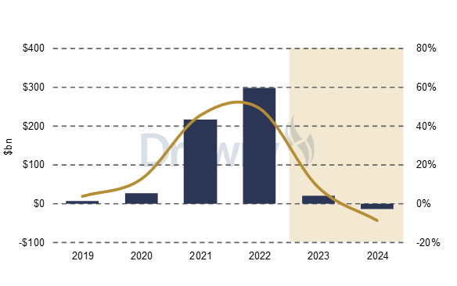

Slide 4
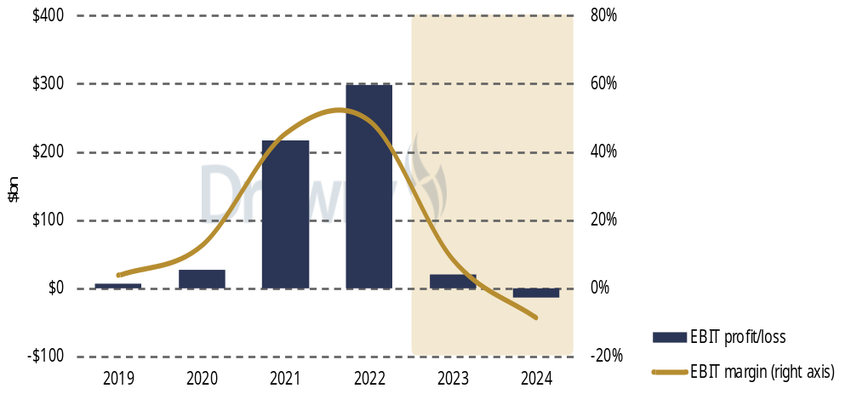
Forecast Carrier Industry Ebit Profit/Loss And Ebit Margins
Carriers expected to make EBIT profit of $20bn for 2023, but lose $15bn next year as freight rates continue to slide.
Source: Drewry Maritime Research

Slide 5
Container Shipping Industry – Financial Performance
Despite its huge contribution to the trade-driven prosperity of the world, liner shipping has historically not been a big money-spinner.
Carriers earned more in pandemic than during entire previous history combined.
With those exceptional conditions behind us, liner profit margins expected to resume at “normal” levels.
EBIT margins for shipping lines, long time series, annual
Source: Drewry Maritime Research - Container Forecaster (Jul-23)

Slide 6
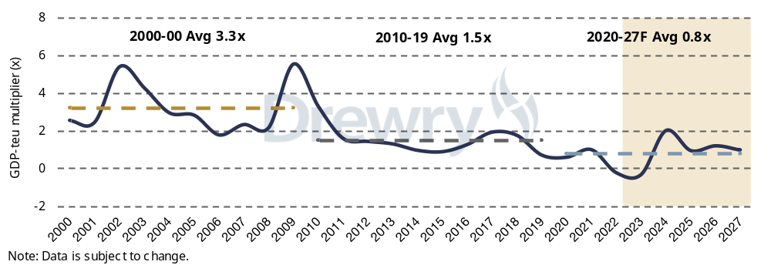
Disconnect with economic activity
The relationship between GDP and teu is expected to resume normal service once the after shocks of the pandemic have receded.
The demand surge created an unnatural high, while the subsequent pinch on consumer spending power has left a deep void in the container market, even while the broader global economy pushes forward.
GDP-teu (loaded containers) multiplier
Source: Drewry Maritime Research

Slide 7
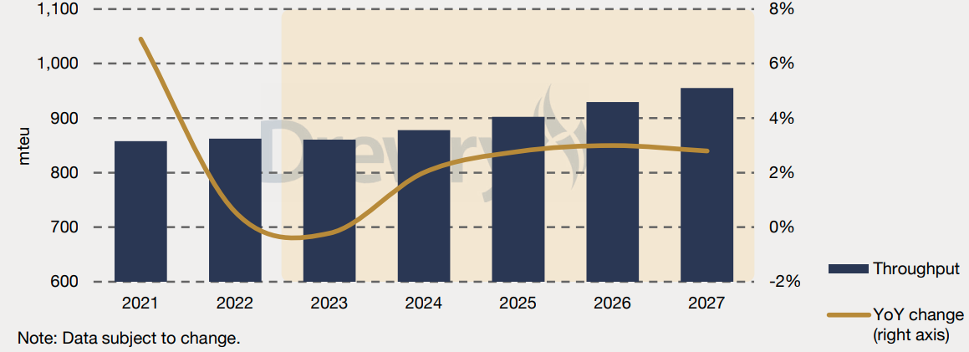
Global container port throughput
Global throughput for 2022 was only +0.6%
Outlook for 2023 and 2024 downgraded to -0.2% and +2% respectively
Forecast for 2024 at just 2% far below that of previous bounce-back years.
Source: Drewry Maritime Research

Slide 8
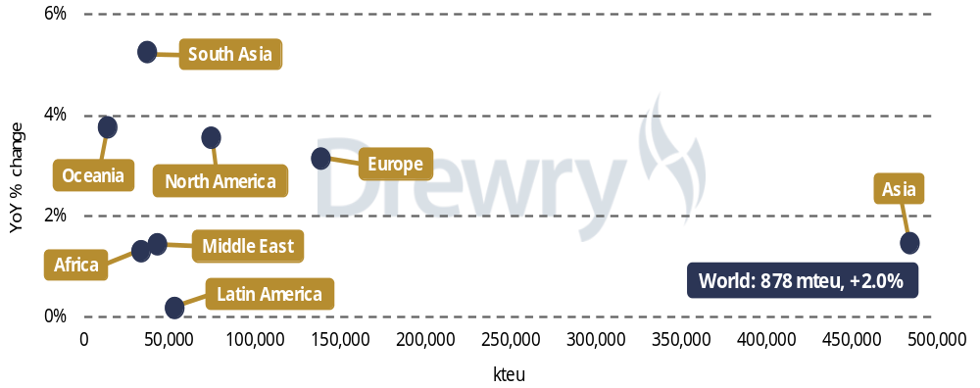
Global Container Shipping Demand Outlook 2024
Our forecast for 2024 reflects a lower baseline, but at just 2% it also signifies a pretty muted market, far below that of previous bounce-back years.
Western economies of North America, Europe and Oceania reside in middle-tier in terms of growth, mainly because they have suffered most this year and therefore have a greater opportunity to bounce back.
Source: Drewry Maritime Research

Slide 9
Development of containership fleet and outlook
Ships ordered in the market boom are now being delivered.
For this year we expect the fleet to increase by 7.2% after accounting for deliveries, slippage and scrapping.
Expected to breach 30 million teu in 2025.
Cellular containership fleet and annual growth rates
Source: Drewry Maritime Research - Container Forecaster (Jul-23)

Slide 10
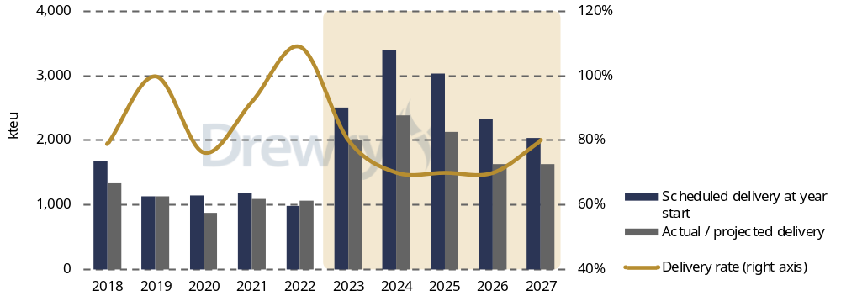
Global Container Shipping Supply Outlook
World containership fleet to increase by 6.4% in 2024 after accounting for deliveries, slippage and scrapping.
Between 2022 & 2024, 3.6 million teu added.
Between 2022 & 2025, 5.0 million teu added
Source: Drewry Maritime Research

Slide 11
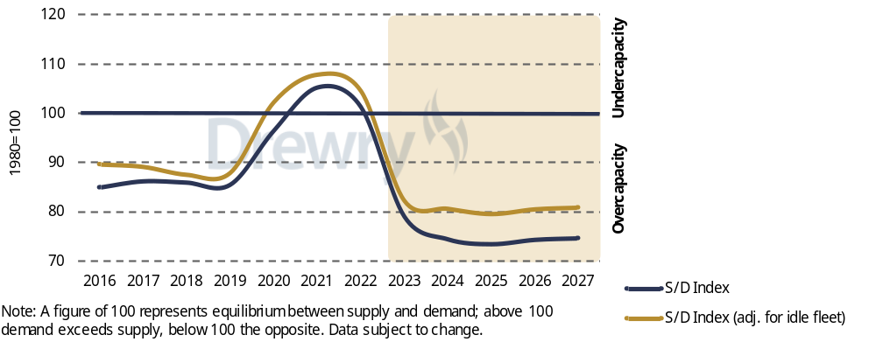
Drewry Global Supply-Demand Index
For 2024, the Drewry global supply/demand index is projected to set a new all-time low of 74.3 (before any adjustment for idle ships).
Assumptions:
Newbuild delivery rate 80%
Demolitions 600 kteu
Avg ship speed 13.8 knots (-1% YoY)
Source: Drewry Maritime Research

Slide 12
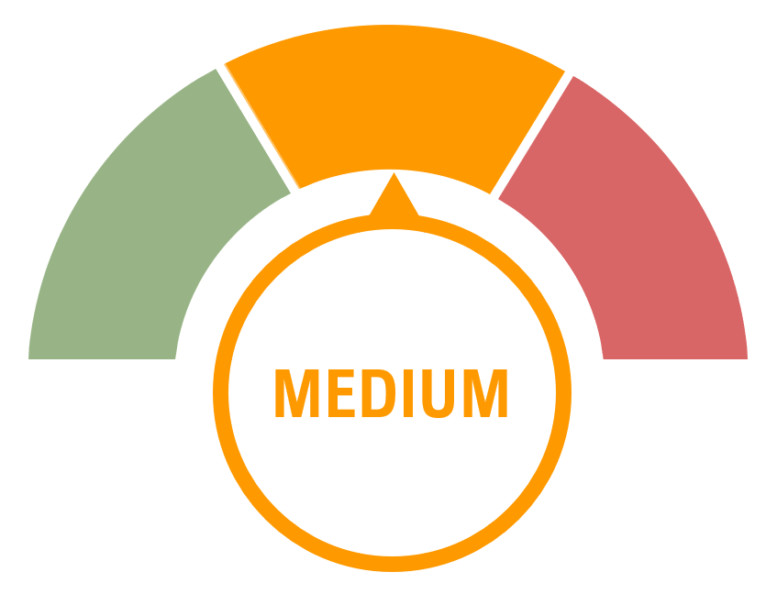
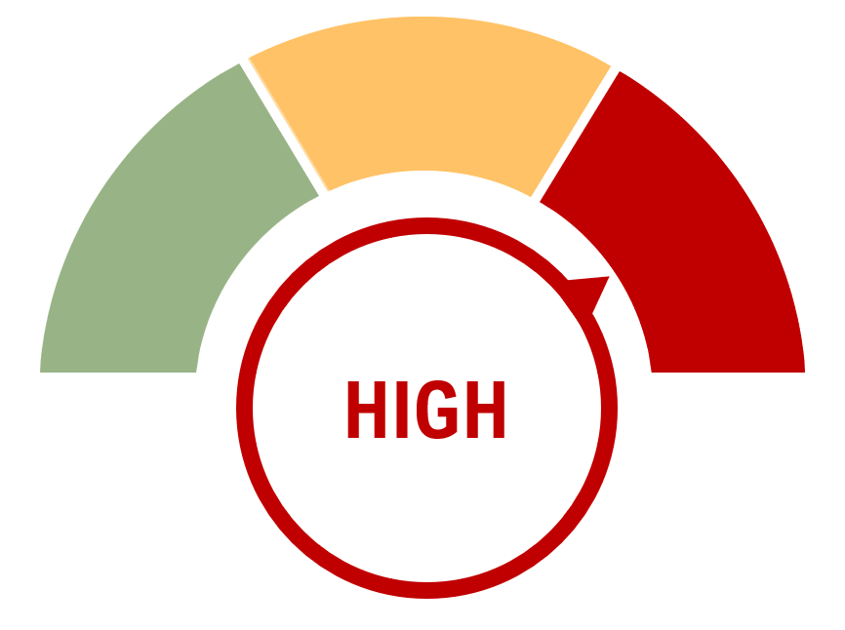
Summary of Market Threats
RISK
LEVEL OF UNCERTAINTY
DISRUPTION IMPACT
REMARKS
Carrier Behaviour
Carriers clearly price takers and only now tackling capacity with concerted effort
Global Economy
High inflation remains a drag
Geopolitical Situation
Tensions are still running very high
Port Congestion/Labour issues
Improving steadily, risks remain
Regulatory/ESG
More ambitious target from IMO welcome, details of carbon pricing starting to appear
Black Swan Risks (i.e. Extreme climate events)
Frequency of extreme events impacting shipping on the rise

Slide 13










Container shipping alliances
The structure of alliances has changed over the past few years, with the latest three-alliance structure taking effect from April 2017
Top 10 carriers now operate approximately 85% of the containership fleet.
2M Alliance
Established in 2015 for 10 years to 2025,
To terminate.
Zim participates on niche trades only.
.
Ocean Alliance
Established in April 2017, initially for 5 years. Extended in 2022 for another 5 years until 2027.
THE Alliance
Founded in April 2017. HMM joined in April 2020 when the four members extended the cooperation until 2030.
Source: Drewry Maritime Research

Slide 14
Critical Questions
Impact on Freight Forwarding
Is an oversupply market good for shippers ?
- yes, in terms of lower freight.
- but more supply chain challenges ?
Is an oversupply market good for freight forwarders ?
- opportunity to help BCOs navigate the complexities
- depends on ability to stay on top of the game.
- tools ?

Slide 15


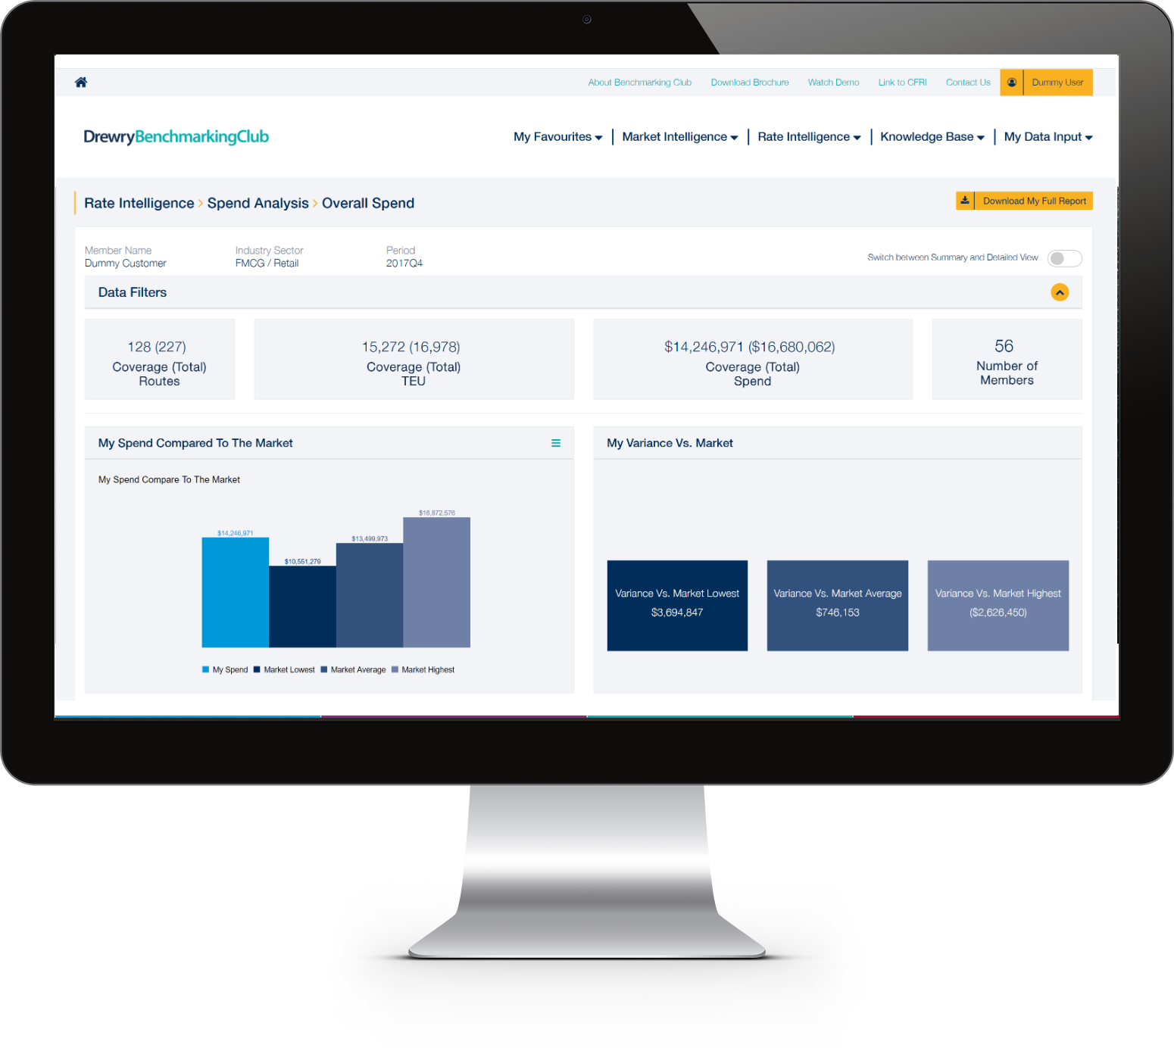
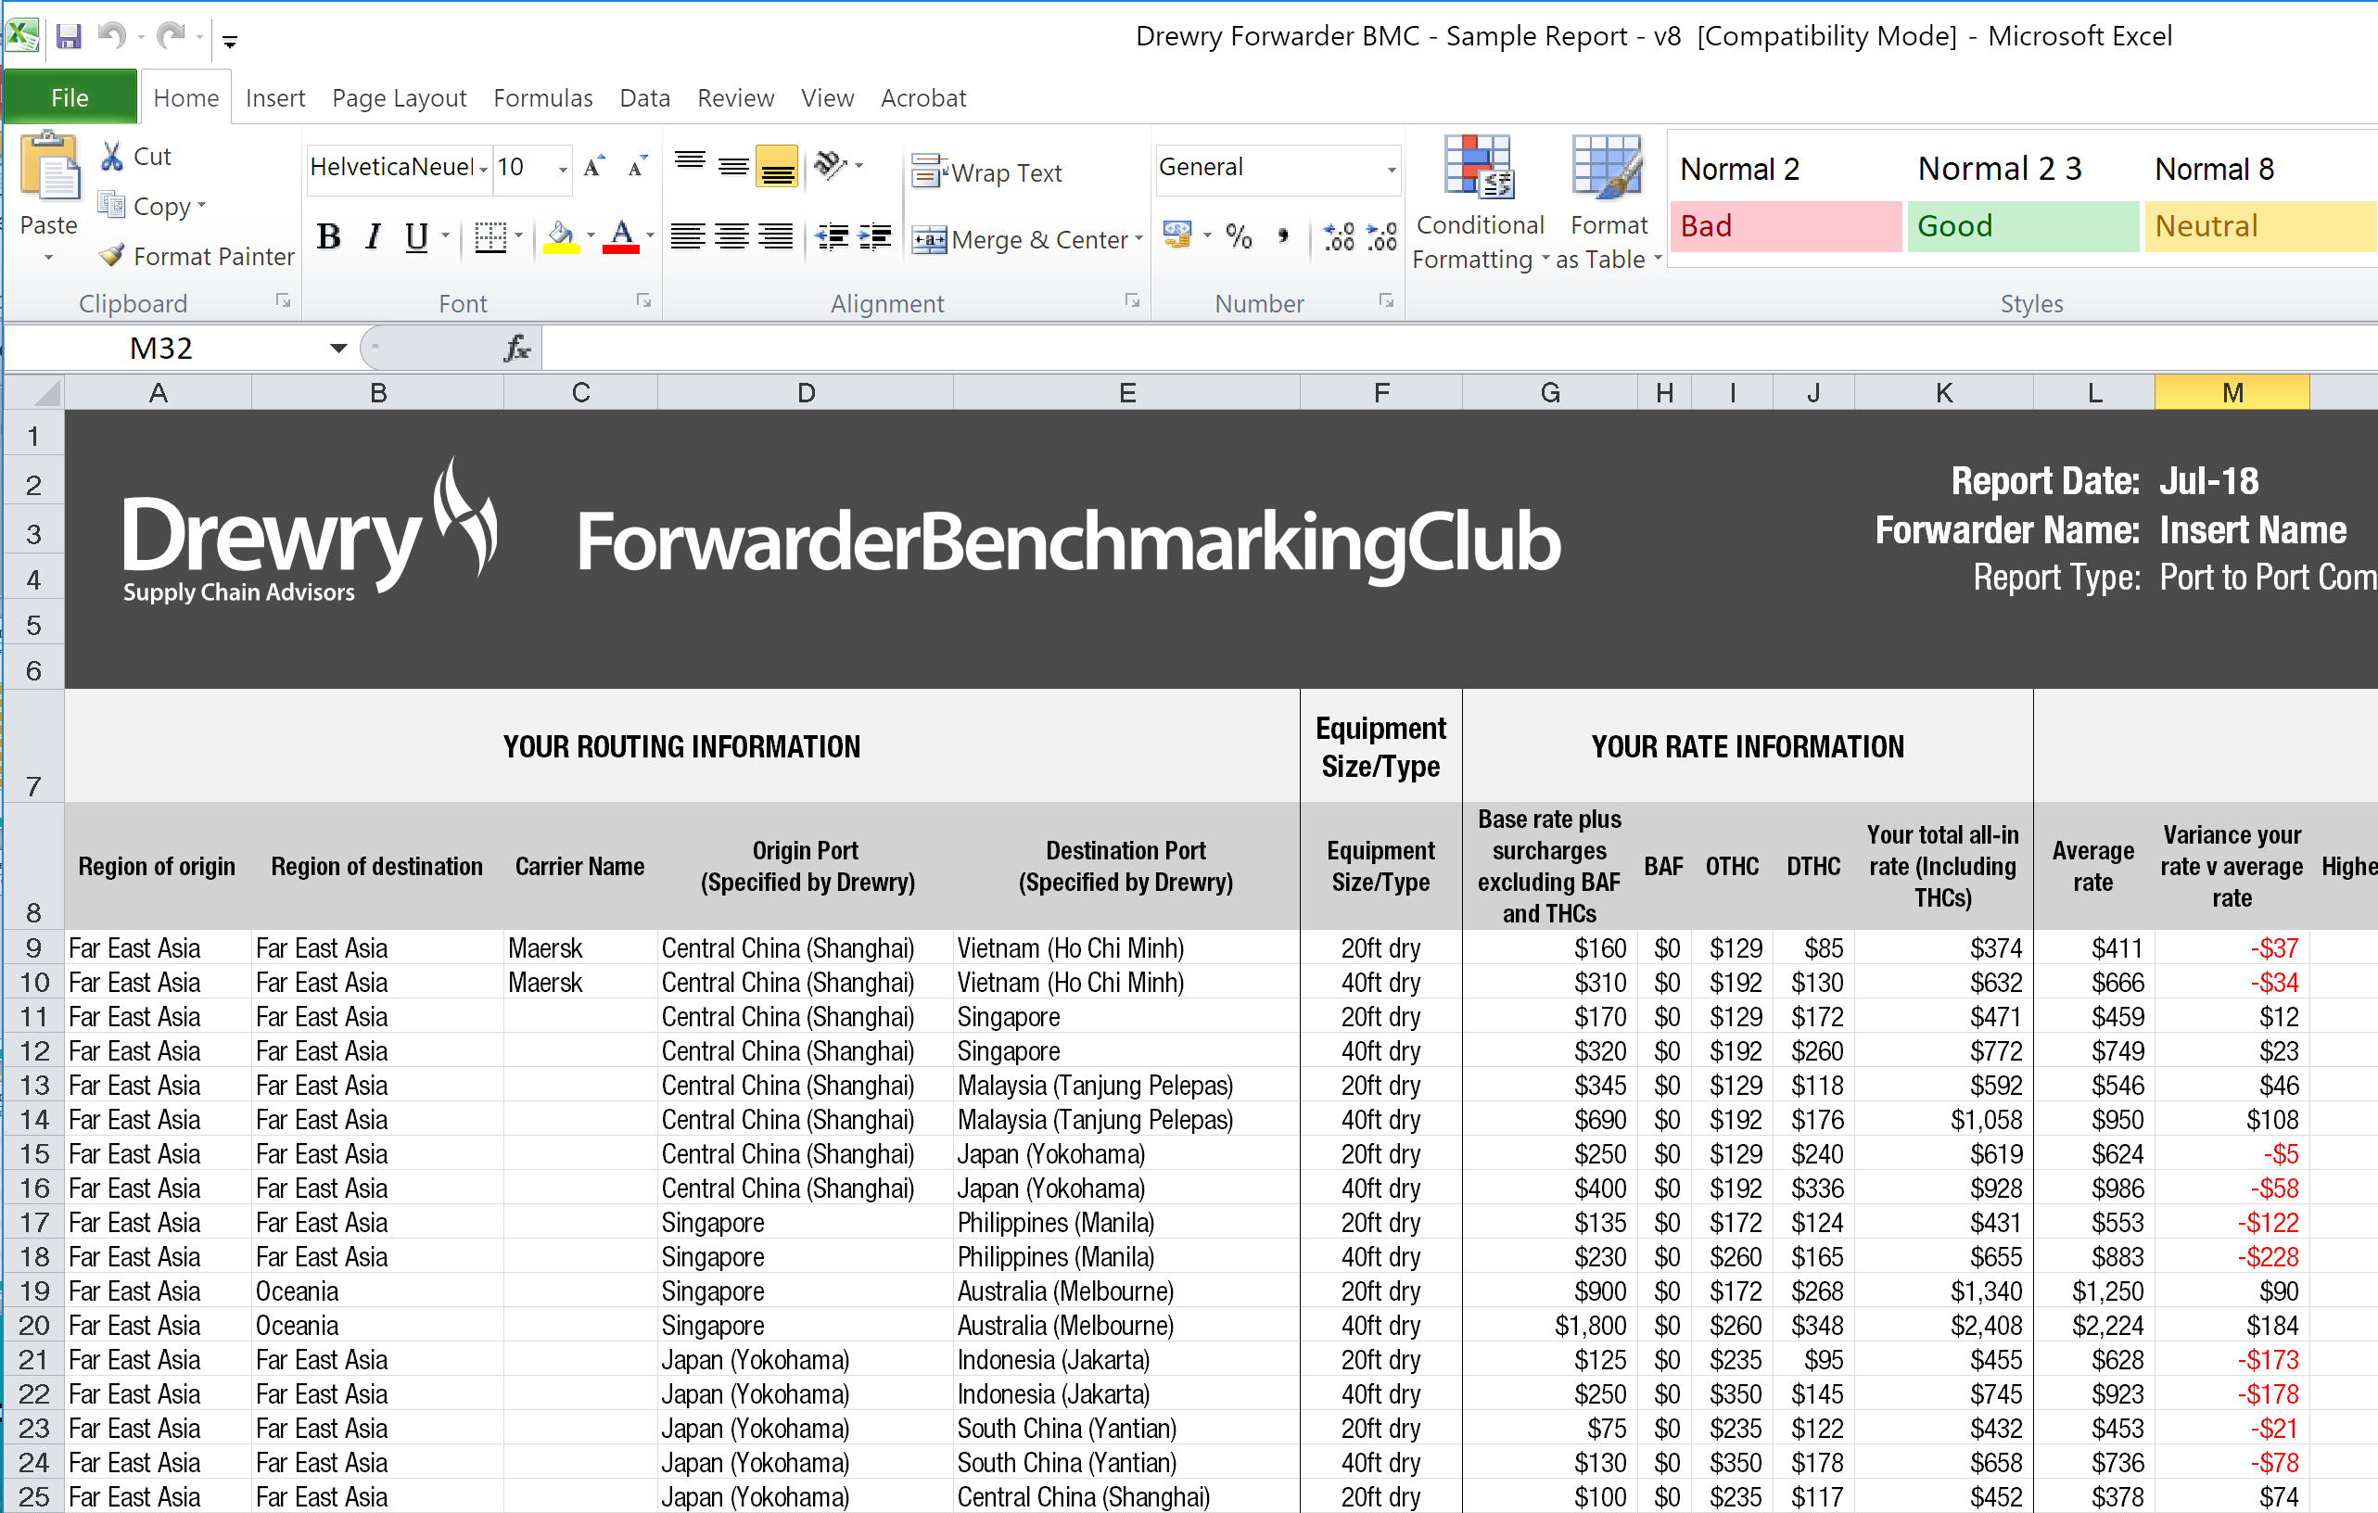
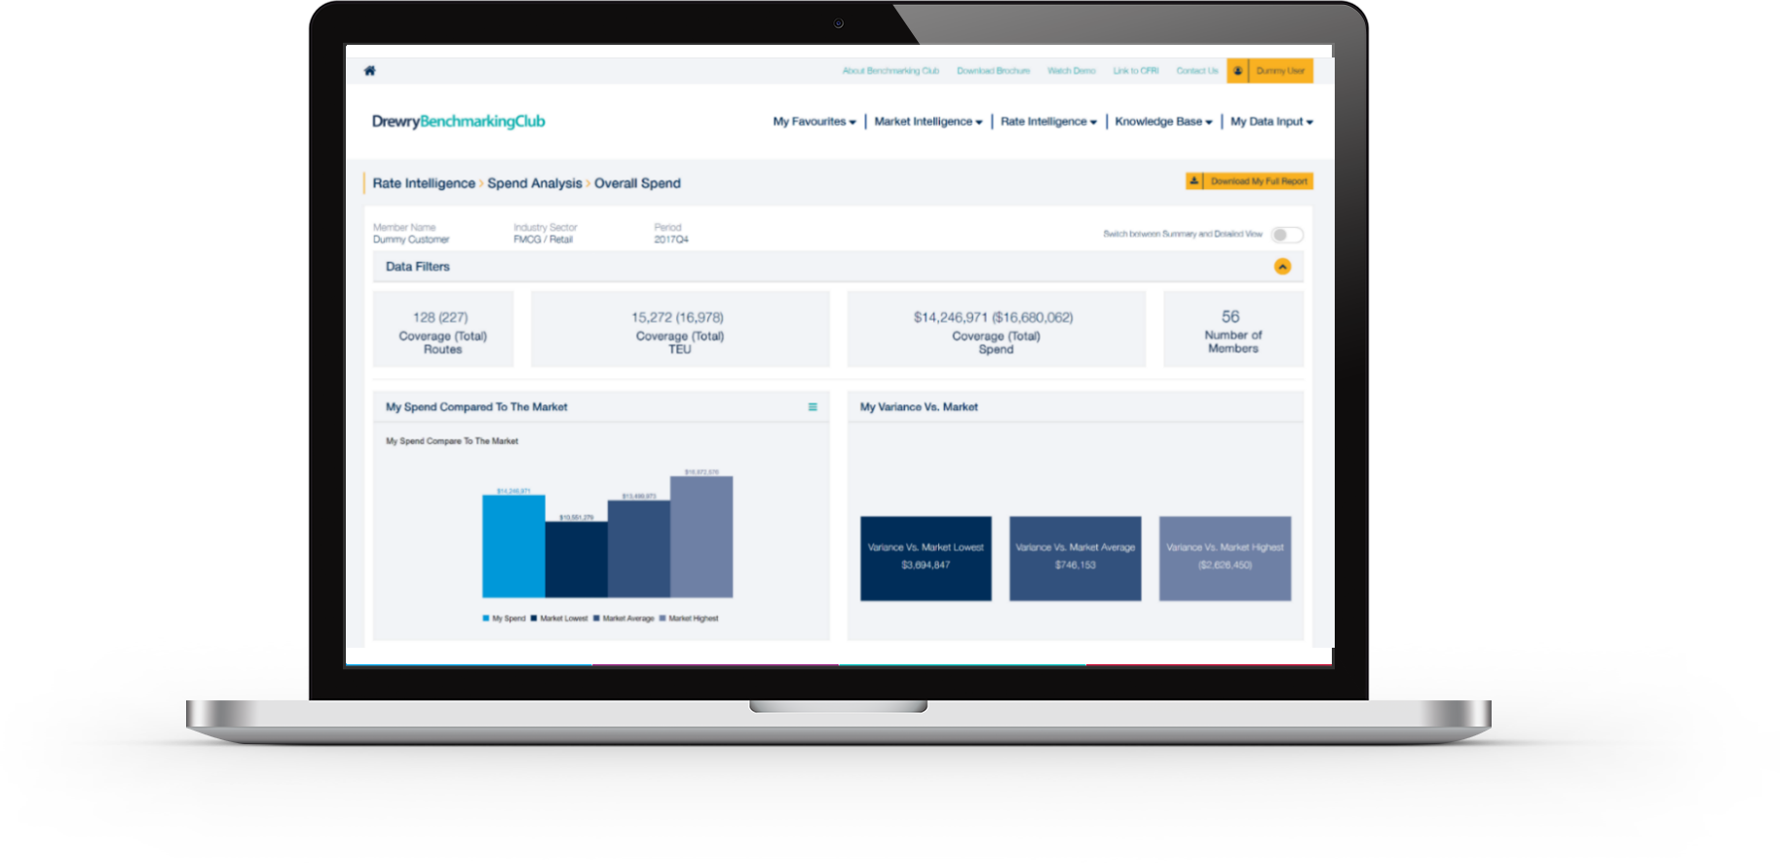
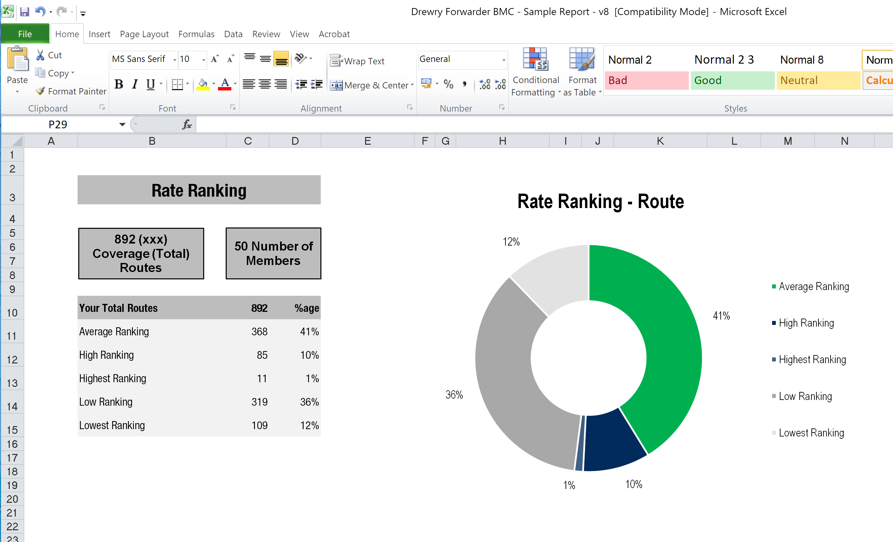
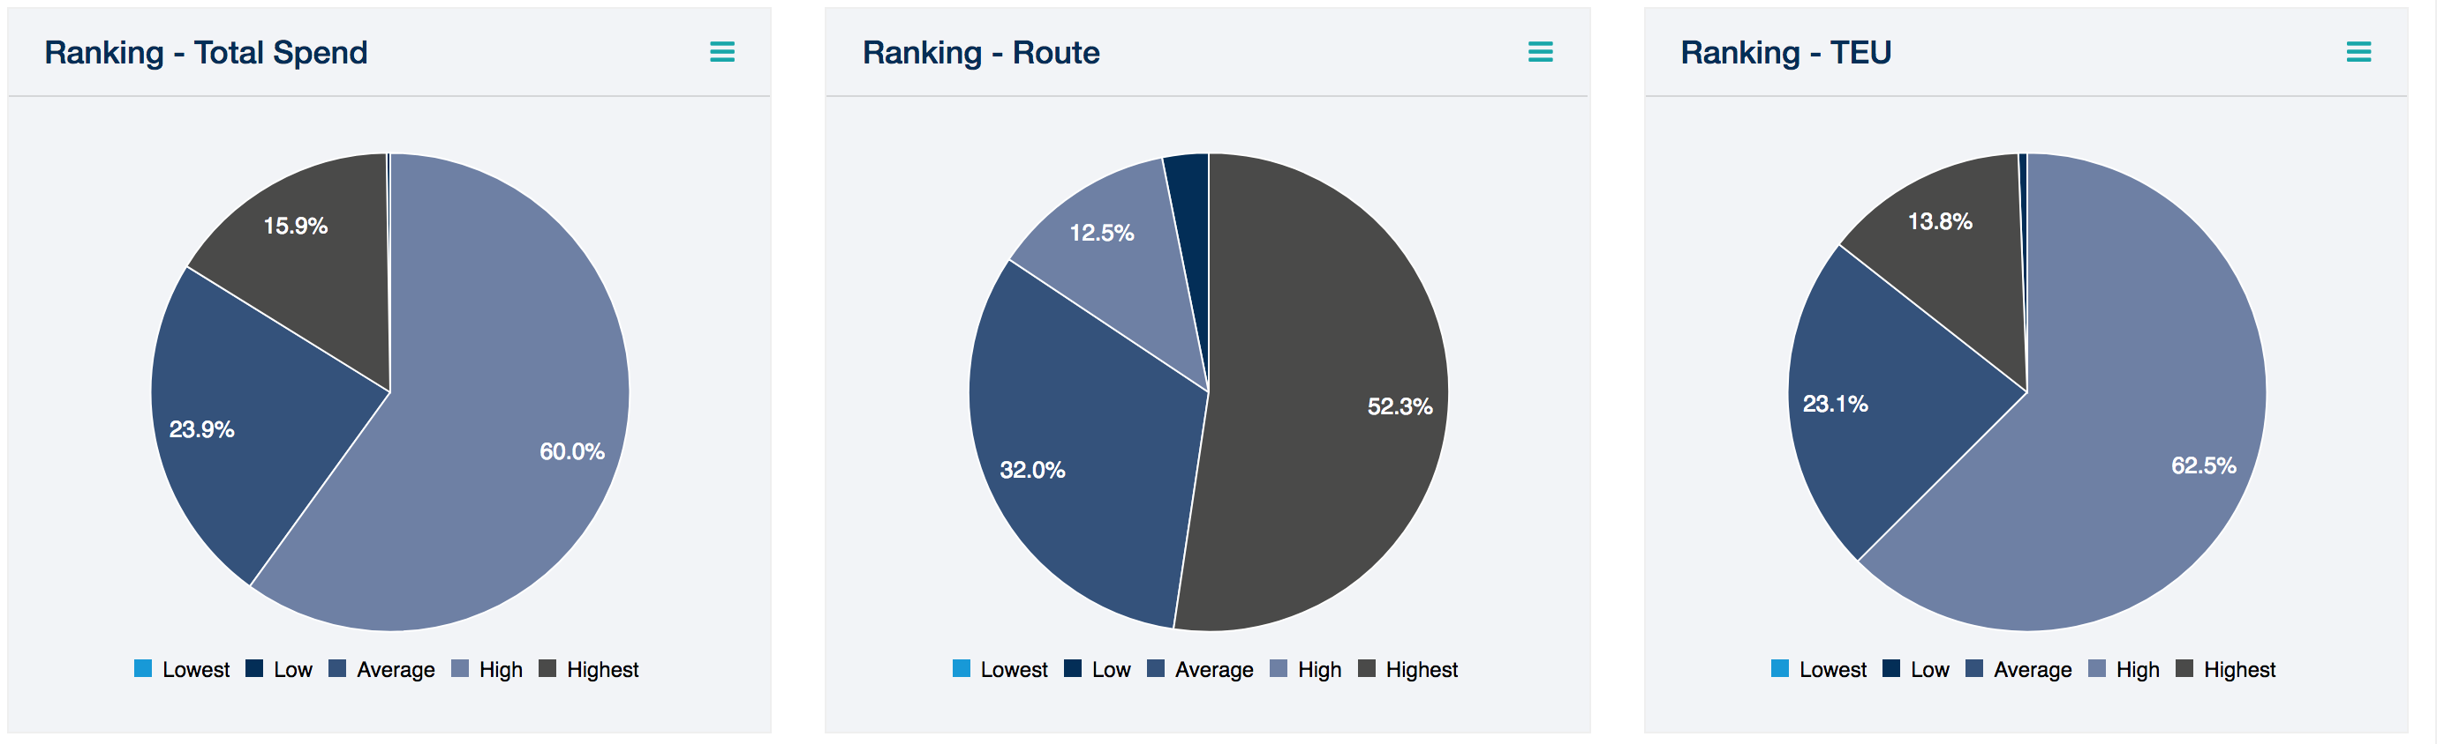
… in a nutshell:
✓
Exclusive to Forwarders and NVOCCs
✓
Confidentially benchmark FAK buy-rates with ocean carriers
✓
Individually customised monthly reports for each member
✓
Free access to exclusive market outlook briefings

Slide 16

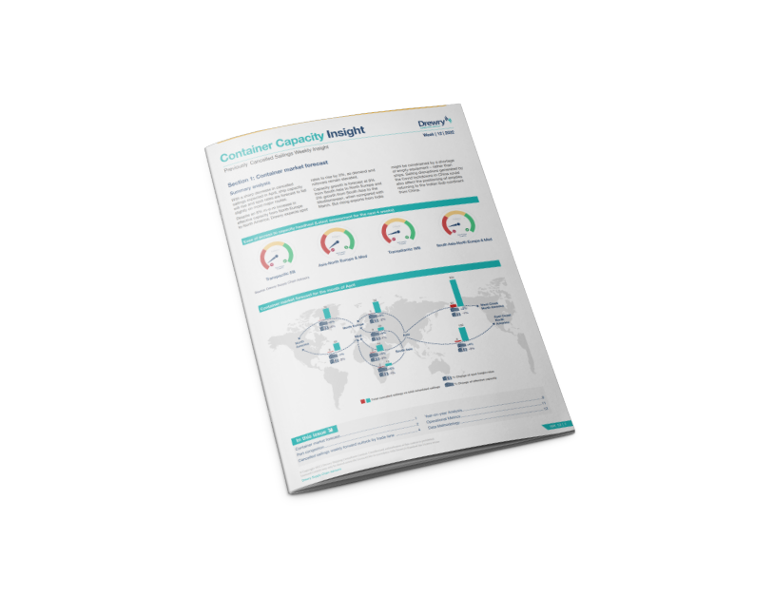
Container Capacity Insight
CCI is designed to provide shippers and freight forwarders a weekly visibility on key market drivers, supported with AIS ship tracker data, to proactively manage their operations and implement effective internal communication based on short term forecasts and real time data.
Client Use
Container Capacity Weekly Insight
Client Type
Understand
Digest
Communicate
Avoid disruption
Get ready to face disruption
Mitigate disruption’s impact
Monitor
Cancelled sailings
Scheduled sailings
Capacity
Port congestion
Spot rates
Actual transit times of selected lanes
Predict
Cancelled sailings
Scheduled sailings
m-o-m capacity fluctuations
m-o-m spot sates fluctuations
Freight forwarders
Shippers and BCO’s
Terminal operators
Port authorities
Banks
Consultancy firms
Transparency & visibility
Tracking & tracing
Planning & Forecasting
Inventory management and lead time
1
2
Client Needs
Deliver
dynamic visibility on
Port congestion
Cancelled sailings
Blanked vessels
Spot rates
Capacity
Weekly key market insights
Analyse
Assess
Compare
y-o-y
m-o-m
w-o-w
4
3
Container Capacity Insight

Slide 17
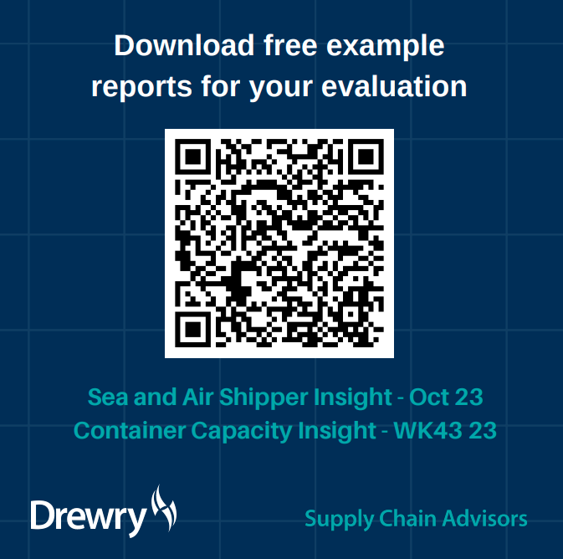
https://www.drewry.co.uk/example-reports

Slide 18
contact us supplychains@drewry.co.uk

