Slide 1

Cargoo presentation
November 16th, 2023

Slide 2

01
Cargoo Solution
02
Cargoo Collaboration & Integration
03
Cargoo Business Intelligence (KPI & Power BI)
04
Cargoo RMS Solution (Rates & Allocation)
05
Cargoo TMS Solution
06
Cargoo DMS Solution

Slide 3
01
Cargoo solution

Slide 4


Business organization
Estonia - Tallinn
Germany - Hamburg
Switzerland - Wollerau
USA- Miami
Egypt - Kairo
China- Shanghai
Hong Kong
Costa Rica- San Jose
Philippines - Manila
India - Bangalore
Vietnam - Ho Chi Minh City
Singapore
Brazil- Sao Paulo

Slide 5






Global Business
163,253+
224,500,000+
688,435
Business Partners
+89% compared to Jan 2022
Container Events
+95% compared to Jan 2022
Shipments Placed
+66% compared to Jan 2022
3,024,542
6,000+
2332+
TEU Processed
+73% compared to Jan 2022
Unique Users
+66% compared to Jan 2022
Companies
+40% compared to Jan 2022

Slide 6
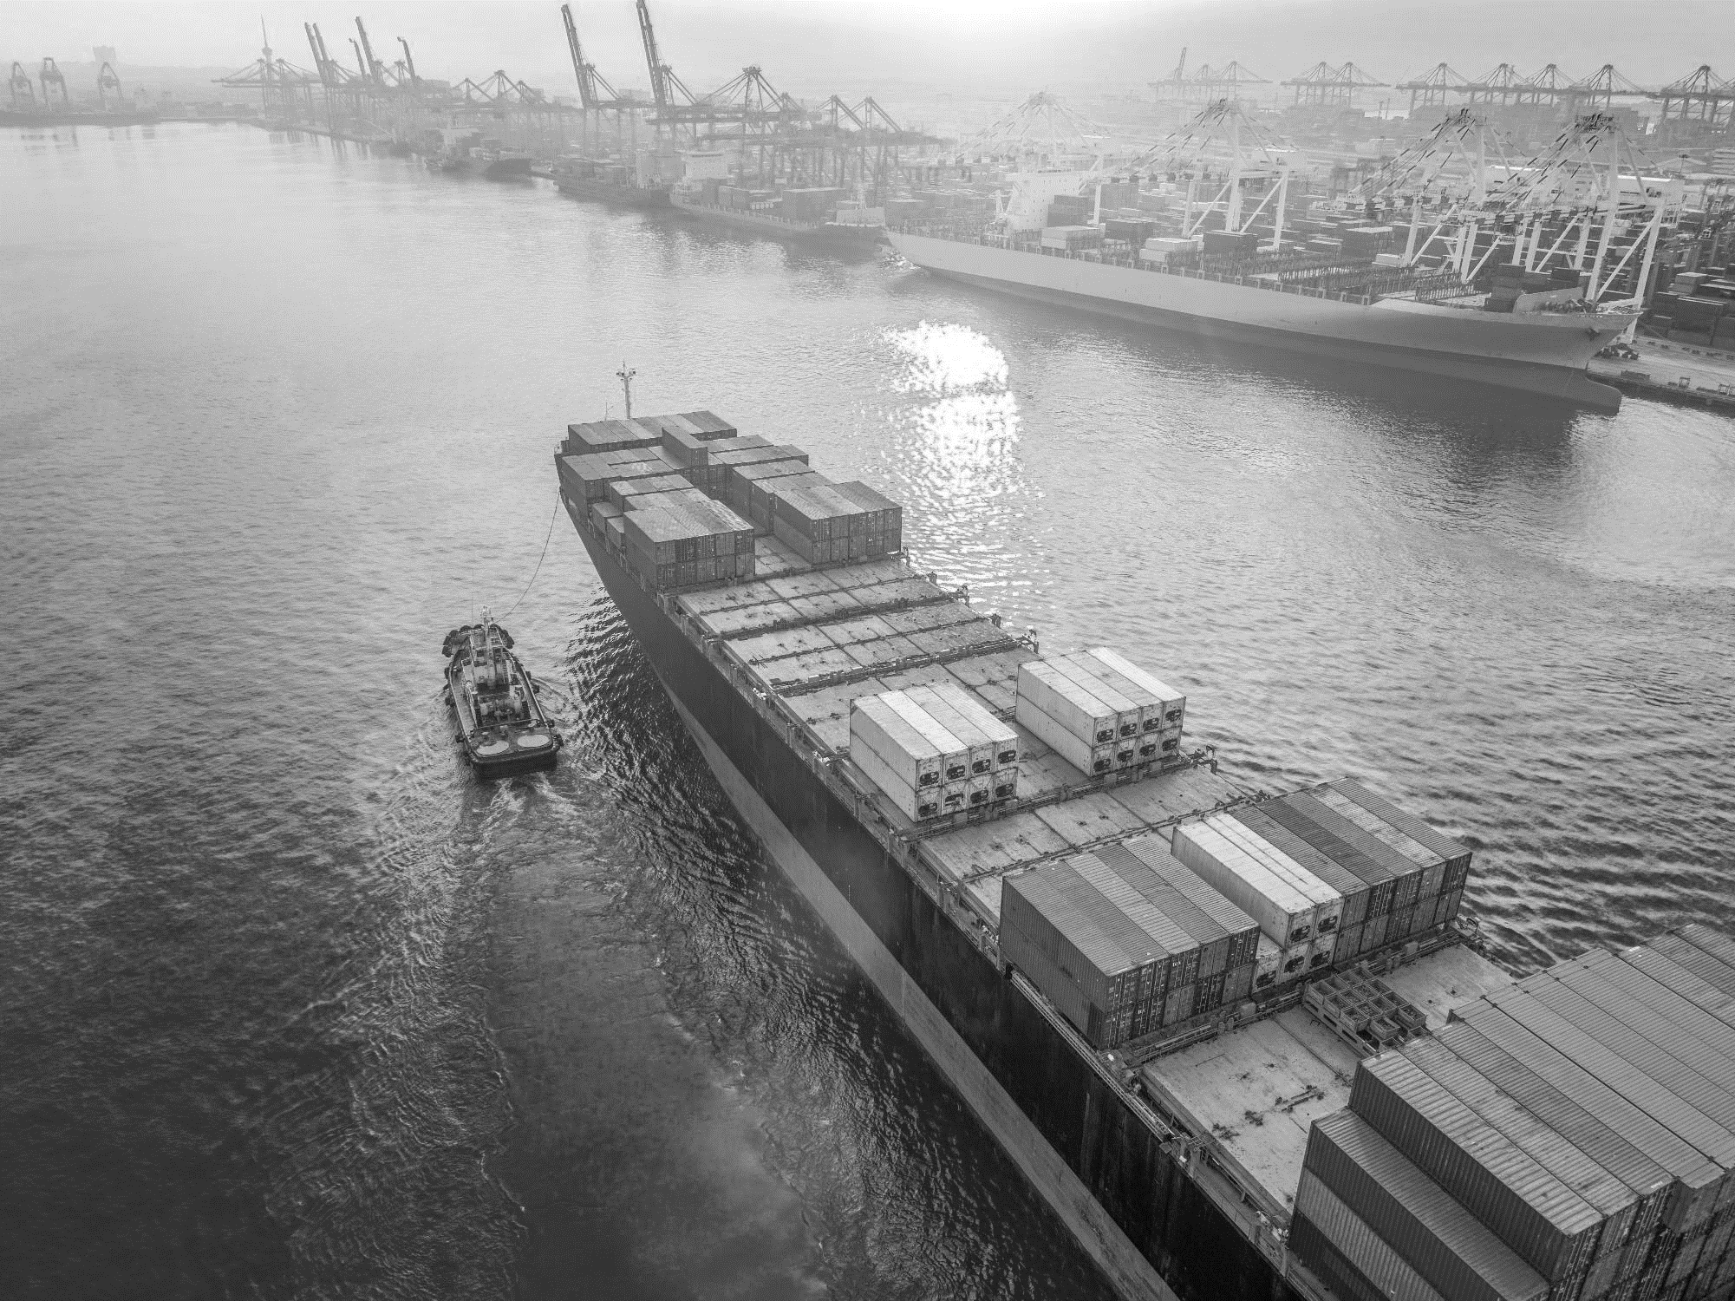

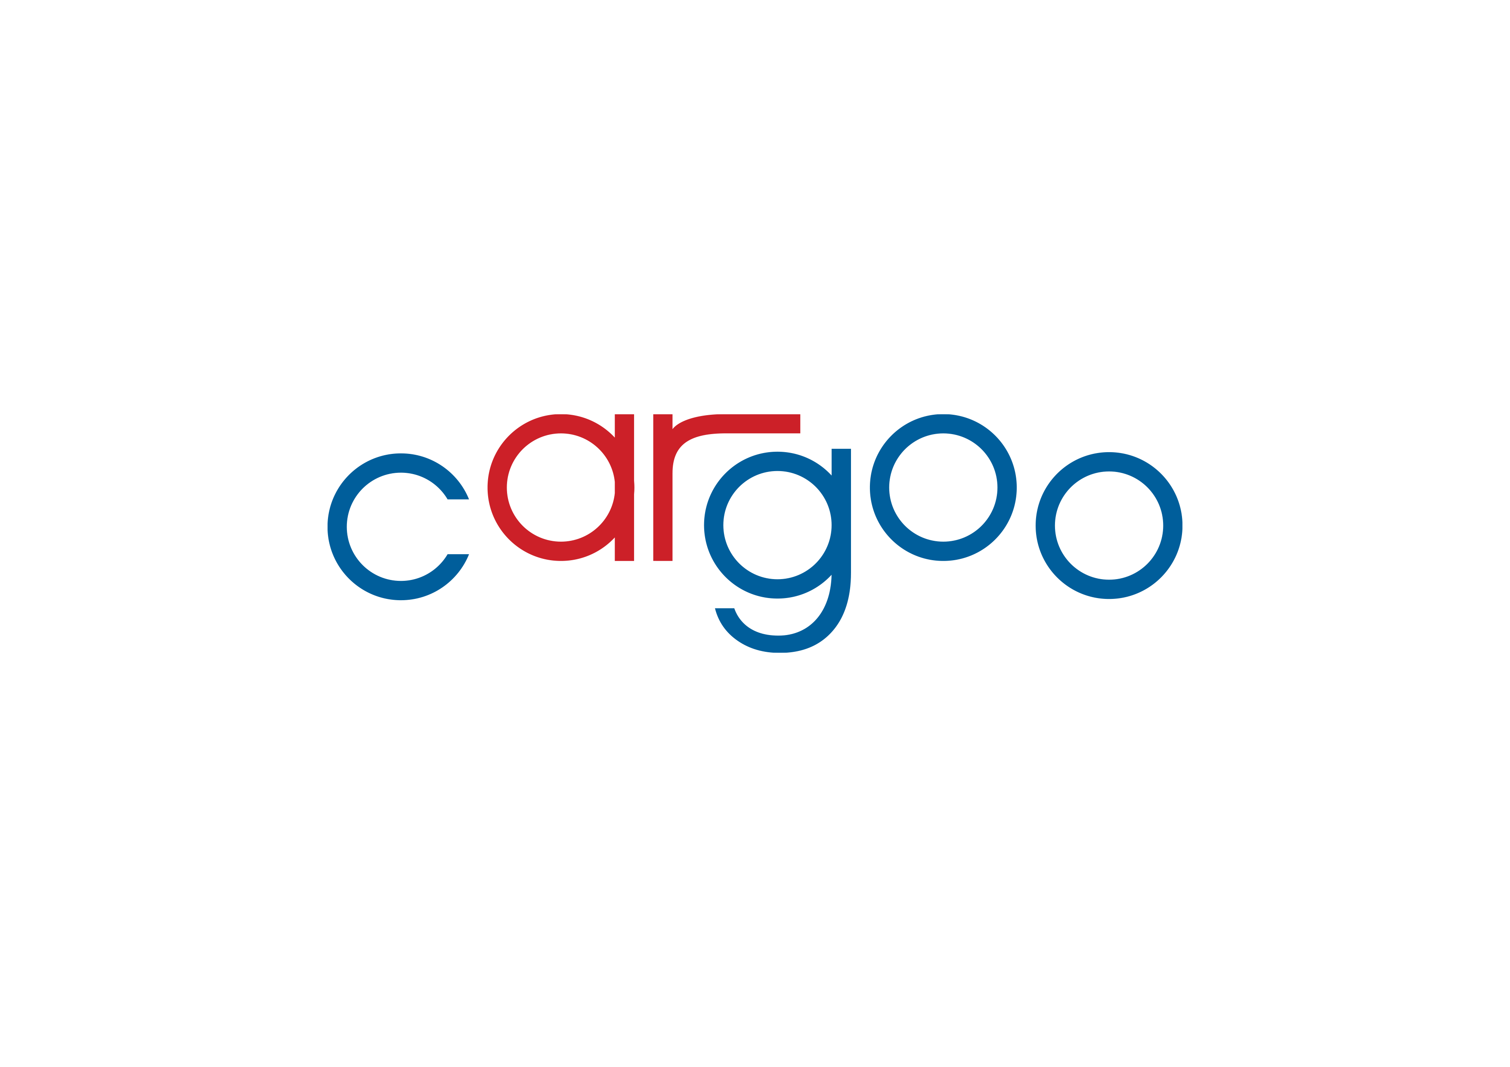








cargoo evolution
An expert system for logistics, designed by logistic experts:
Our capabilities are proven. Cargoo has been developed by senior staff who have worked in commodity trading, food processing and FMCG businesses and of course logistics for years.
2009
…
2013
…
2016
2017
2018
2019
2020
2021
2022
2023
CSA Shipping
CSA Ocean
Largest EU retailer
Notes:
Visibility: Cargoo provides access to reliable, high-quality container data. This allows companies to collaborate easily, supporting efficient digital processes and sharing real-time container shipment data. Cargoo offers the most expansive global ocean carrier coverage, with 98% of the world’s ocean container capacity. Data insights from carriers help Cargoo users make informed, real-time decisions using financial ETAs, automated exception detection, and proactive alerts.
Control: Cargoo allows seamless collaboration between all parties to a shipment playing a critical role in connecting end-to-end supply chains. As a direct plug-in into existing ERP platforms, Cargoo automates manual tasks, such as phone calls, email, and data entry. With greater transparency and control, all parties to a shipment can proactively address supply chain disruptions
Manage Costs: With digitalization and data transparency comes a more efficient and effective supply chain. The
Sustainability: Cargoo is passionate about helping global shipping companies address sustainability by measuring accurate, accredited carbon emissions and reporting this data. This helps companies evaluate their progress in reaching supply chain CO2 reduction targets. Moreover, this system supports a speedier, streamlined, and more sustainable route to market.

Slide 7




cargoo Purpose
To create a new industry standard for Supply Chain Management with a platform like no other with a customer-centric approach
Visibility, Execution & Control
Collaboration,
Integration & Digitalization
Efficiency &
Cost reduction
Carbon Footprint
Management
Notes:
Visibility: Cargoo provides access to reliable, high-quality container data. This allows companies to collaborate easily, supporting efficient digital processes and sharing real-time container shipment data. Cargoo offers the most expansive global ocean carrier coverage, with 98% of the world’s ocean container capacity. Data insights from carriers help Cargoo users make informed, real-time decisions using financial ETAs, automated exception detection, and proactive alerts.
Control: Cargoo allows seamless collaboration between all parties to a shipment playing a critical role in connecting end-to-end supply chains. As a direct plug-in into existing ERP platforms, Cargoo automates manual tasks, such as phone calls, email, and data entry. With greater transparency and control, all parties to a shipment can proactively address supply chain disruptions
Manage Costs: With digitalization and data transparency comes a more efficient and effective supply chain. The
Sustainability: Cargoo is passionate about helping global shipping companies address sustainability by measuring accurate, accredited carbon emissions and reporting this data. This helps companies evaluate their progress in reaching supply chain CO2 reduction targets. Moreover, this system supports a speedier, streamlined, and more sustainable route to market.

Slide 8










Cargoo design for e2e Supply chain excellency
Business Intelligence
DND & Freight Audit
Carbon
Footprint Management
BUSINESS INTELLIGENCE
Sailing
Schedules
& Carrier
Services
Allocation Management
Rates &
Contract Management
Document Management System
Digitalization of Documents
Tender Management
Tracking & Tracing
Vessel Positioning
Booking & Shipments
Exception Management
Order Management
Vendor
Booking Portal
WORKFLOW ENGINE
TMS
RMS
DMS
Notes:
Order Management: Cargoo enables order lifecycle management visibility
connecting your supply chain operations to give a single view of purchase & sales orders, shipments, and inventory.
Booking & Shipments: Cargoo enables your vendors and booking agents to arrange shipment directly with carriers or logistics providers,
while giving you the overview required to control all activities and exceptions in your supply chain.
Tracking & Tracing: With Cargoo, you obtain complete visibility allowing you to view, manage and optimize your global supply chain in real-time. Our value lies in the amount, accuracy, and timeliness of the supply chain data we collect, clean, normalize, analyze and enrich before making it available to all parties involved.
We use Application Programming Interfaces (APIs), IoT, Artificial Intelligence (AI), and other technologies to collect real-time supply chain data across transportation modes and stakeholders. It is easier for businesses to view, analyze and act upon real-time information from the planning of a shipment to transport and delivery.
Document Management System: Powerful, sophisticated, and user-friendly DMS tool. Create, file, and share documents, and manage by exception. Digitalize documents & workflow: eliminate documentation gaps with 100% paperless documents.
Tender Management: Cargoo enables you to handle your tenders directly with carriers. It manages the information content of a tender being issued, the administration process of giving tenders and receiving bids, the content and structure and production of the bid submission and time and resource management for the bidder; the record-keeping and audit trail of changes; a repository of all documentation.
Rates & Contract Management: Cargoo lets you centralize freight rates and contract management in one place. Access not only your contract rates but also the spot market. Collaborate with your colleagues and business partners in real-time, and book and delegate shipments based on your current contract rates. Gather historical data and gain insights from rate history, as well as get your benchmark data
Sailing Schedules & Carrier Services: Cargoo enables fast, fact-based decision-making with real-time sailing schedule information. Choose the right carrier option for your shipments, comparing port-to-port transit times & costs. Measure and reduce the environmental impact of your transport.
Allocation Management lets you forecast and plan your volumes and connect with ocean carriers to determine the most optimal flow of products. Drives carrier visibility for more accurate and timely forecasts, enabling optimal capacity planning. Expand metrics for carrier commitments and develop process enhancements
Carbon Footprint Management: Create transparency by measuring and monitoring C02 emissions throughout your supply chain. Optimize your container loads to reduce carbon emissions.
Business Intelligence: Improve daily operations with better strategic planning and quality improvement. Real-time dashboards using displays and numerical KPI displays let you see the ‘situation at a glance. Reporting and detailed measurement of the performance of your carriers, shippers, and vendors. Insight to create better efficiency, reduce costs and drive improved profitability

Slide 9

Nestle & Cargoo partnership delivering EFFICIENCY & COST REDUCTION
Using real-time dashboards with reporting and detailed measurements of the performance of carrier shippers and vendors gave Nestle a better understanding of the inner workings of its supply chain. Specific, clear, and actionable information improved their ability to identify opportunities for strategic change and alterations to transportation and logistics operations in real time. This drives increased supply chain efficiency, operational performance improvement, and reduced costs.
Benefits Nestlé gained from using the Cargoo digital gateway. (Phase 1 – one year)
Significant cost savings:
25%
10%
31%
Reduction in costs
Cost savings
Cost savings
Demurrage & Detention
Efficiency savings
Overall freight costs

Slide 10


collaboration case study
For Sucafina, supply chain digital transformation started by bringing all the parties in the supply chain together in one platform, simplifying the creation and exchange of documents, tracking information and changes, and storing all shipping and commercial documents in a reliable, efficient, interconnected, and secure manner.
Benefits Sucafina gained from using the Cargoo digital gateway.
Connected
Productivity boost
Compliance
Participants from source to consumer via a single source of truth, making document management a convenient and cost-efficient activity.
Reduced process time from
minutes to seconds.
State-of-the-art technology substantially mitigated fraud risk

Slide 11
02
Cargoo collaboration & integration

Slide 12










Customer & CARGOO PARTNERSHIP
Manufacture / Brand owner
Buyer
Business Partner Flow
Access
Access
Access
Access
Access
Integration
Order
Transport Management System
Partner Visibility
Shipment Delegation
Shipper Visibility
Shipment Delegation
Exporter Visibility
Shipment Delegation
Trader Visibility
Shipment Delegation
Buyer Visibility
Rate Management System
Document Management System
Logistics Flow

Slide 13












Partner integration
Ocean Carriers
Direct EDI/API Connections With Ocean Carriers + 95% of all global container capacity
Business Partners
Existing & New Projects/Partners In Development
IoT Data
Spot Rates
Invoice
B/L data
API Products
AIS Data
Available Flows EDI/API
01
02
03
04
05
06
Sailing
Schedules
Booking
Cycle
Carrier B/L Instructions
Copy
B/L PDF
VGM
Track &
Trace

Slide 14
Cargoo – data quality

Slide 15
T&T Completeness KPIs
Q1 - Q3 2023
Origin Events
Destination Events
CEP | CGI | CLL | VDL | VAD | CDD | CGO | CER | 8/8 Event completeness | 6/8 Event completeness
Empty Container Provided | Container Full Gate-In | Container Loaded at POL | Vessel Departure | Vessel Arrival | Container Discharged at POD | Container Gate-Out Full | Container Empty Returned
Hapag Lloyd
90.22% | 93.07% | 96.83% | 98.34% | 96.99% | 94.65% | 93.21% | 86.20% | 93.69% | 95.52%
Maersk
87.70% | 96.27% | 96.83% | 96.89% | 95.56% | 93.12% | 92.59% | 84.03% | 92.87% | 95.21%
MSC
88.93% | 92.86% | 97.00% | 94.93% | 94.08% | 93.31% | 90.34% | 80.12% | 91.45% | 93.75%
CMA-CGM
89.88% | 95.70% | 96.20% | 97.73% | 96.70% | 97.51% | 96.66% | 84.08% | 94.31% | 96.75%
ONE
98.25% | 95.98% | 98.63% | 97.80% | 98.64% | 98.02% | 97.68% | 84.34% | 96.17% | 97.79%
EVERGREEN
94.26% | 94.26% | 99.12% | 99.78% | 99.78% | 97.57% | 94.26% | 89.85% | 96.11% | 97.46%
COSCO
99.27% | 96.84% | 96.35% | 98.78% | 98.05% | 96.35% | 92.94% | 71.87% | 93.81% | 96.55%
OOCL
97.10% | 99.28% | 99.28% | 99.28% | 99.28% | 99.28% | 98.55% | 94.93% | 98.37% | 99.15%
94.51% | 96.53%
Based on shipment information for Q1, Q2 & Q3 2023 volumes booked via Cargoo.
Data compiled from different sources (carriers, AIS, visibility partners)
Completed shipments only, data received by EDI & API channels

Slide 16
Booking confirmations KPI

Slide 17
04
Cargoo rMS solutions linked to
Tms solution

Slide 18
Rate management and Tender process
Tender Preparation
Tender
Carrier Contract
Shipping
Freight Audit
Procurement
Carrier/Agent
5
1
Historical data
Prepare Tender Frame
Upload Tender Sheet (lanes)
4
2
Invite Carrier(s)
Export Bidding Sheet
Compare and open next round
Upload Bidding Sheet
3
Award
File Rates
Upload Contract

Slide 19
Rate search – contract rates or spot rates

Slide 20
Simple booking process incl. allocation

Slide 21
Documents on shipment level available

Slide 22
Thank you!

Slide 23
Transport plan visibility
* 10’000 monthly bookings

Slide 24
Booking history at one glance

Slide 25
Container events for end to end visibility

Slide 26
Access to all necessary shipment information
* 10’000 monthly bookings

Slide 27
06
Cargoo DMS solutions

Slide 28
General shipment instruction – Setup documents

