Slide 1






Business presentation
By
Cécile Lammer
Cecile.lammer@ceicia.com

Slide 2
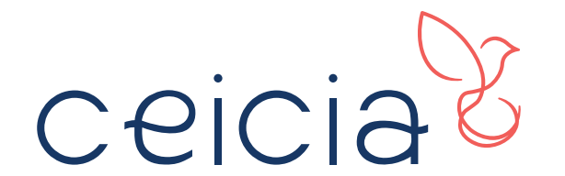
“Talent retention in Challenging Times."
The importance of People Oriented Management
Concept
By

Slide 3


------------
#KUL2023
Thank you for having us

Slide 4
Do you wish to increase your company’s efficiency by keeping your talents, and customers delighted.
Bring passion, success and harmony within your company.
New way of cooperation and harmonization for a global awareness to improve people’s happiness & company’s efficiency.

Slide 5




Disruptions– the new normal
Pandemy, logistics and supply chain challenges, lack of raw material supply, new players, uncertainty…
// New Challenges
The hidden part of the iceberg
In a global and fast-paced environment each decision matter. Focusing on revenues and profits is important but represents only the surface of the iceberg.
Difficulties to recruite and retain talents
Waste of time and knowledge bringing instability and dysfunctions among departments. Decrease of revenue, efficiency as well as rise of discouragement.
Internal organic dysfunctionments
A company is an entire ecosystem that needs to work in harmony. Relationships with managers, communication & lack of flexibility affect the results, time and cost.
In your opinion, what are the criterias for a successful company?
Deficient internal and external communication
Lead to weaknesses and impacts directly the brand image, service quality and overall efficiency.
www.ceicia.com // 5

Slide 6









Reduce your costs by focusing on a sustainable way to maximize your revenues & resources
A new approach towards a global awareness & optimization.
// Solution
Ceicia brings wholesomeness to your business
A company isn’t only « being successful in business ». It is an entire ecosystem in needs of Harmony. Like a concert; each participant has its role. Internal and external environments affect the results, functions and harmony. It is essential to identify those key factors and solve the core issues.
Create an harmonized concentus ecosystem orchestrated for flexibility and success
Each ecosystem needs harmony, the key to long term growth.
Lessen the risk of losing your talents to guarantee quality & internal stability
Employees turnover is the number one visible criteria to evaluate the health of a company.
Why do you need to bring this concept within your corporation?
www.ceicia.com // 6

Slide 7





The reality of the market
// Some figures
30%
60%
80%
30%
N°1
Felt unappreciated
Employees want recognition for their contributions at work.
McKinsey Global Instistute
Average Employee turnover rate
Affecting directly the results of the companies
Main cause of resignation
Poor Management & difficult Relationship with the direct manager
Lack of clear vision & values
negatively impact an organization's performance, reputation, and ability to achieve its goals.
Productivity increase
When employees are offered better communication tools.
Study by Expert Market
www.ceicia.com // 7

Slide 8





// Mike Grundy -
CEO & Co-funder of Amazon Papyrus Chemical
Success story
Founded in 2000 with Hong Kong headquarters, Amazon Papyrus now has an established presence in more than 14 markets with over 460 employees, serving over 350 customers in Asia & Middle East.
How did they reach their goal to compete with USD billon organisations?
www.ceicia.com // 8

Slide 9

How about this picture?

Slide 10



3 main strategies
// Brainstorming time
1
2
3
Set a direction & Long term vision
Trust, empowerment & Recognition
Learning and development
Set up clear and attainable objectives for your team.
Recognize high-performing people with bonus, promotions and awards schemes
Breakdown the short & Long-term objectives.
Everyone should know what is the company trying to achieve.
Participate to elevate your team, provide the right resources, training
Recognize, help your staff to understand the different departments specifications.
“Delivering value through people chemistry”
www.ceicia.com // 10

Slide 11
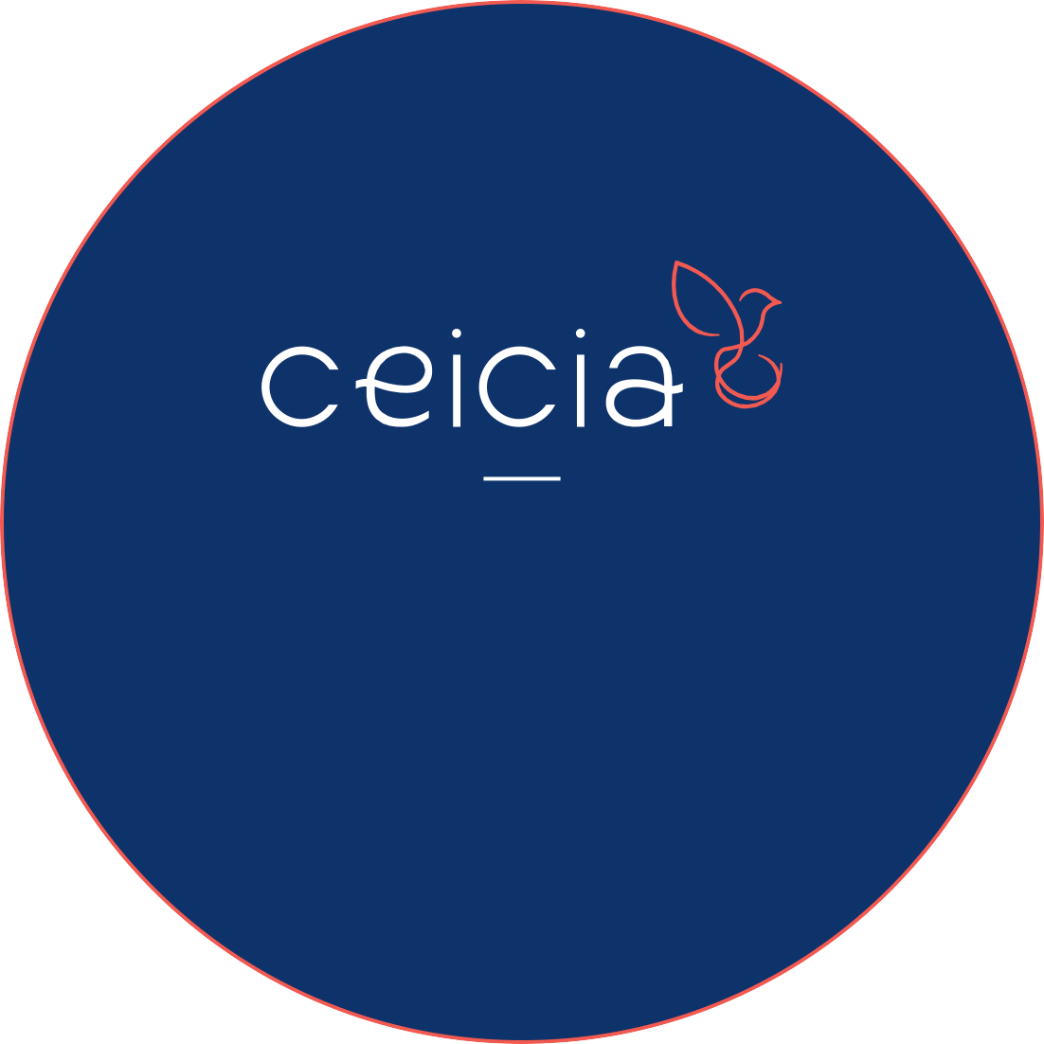
// Success is change
« Whatever the size of your company, we can help! »
The key factor is to understand that whatever the size of your company you will face those challenges. If you want to grow, improve or sustain: those “niche issues” have to be solved. A constant improvement comes from a constant questioning. What can I do better?
Your company is unique so is the way to solve your challenges. Ceicia offers adapted solutions to reach your objectives of continuous improvement. This program brings growth, progess and sustainability to your corporation.

Slide 12



Develop
The longer they stay the more experience they gain to participate to the company success.
// People are key
People are the heart of your company
Great staff bring the utmost to your organization. When the dynamic is positive, staff retention generated a circle of improvement,
Retain
Staff turnover rate is too often minimized and overlooked. It reflects the health of the company.
What is your staff turnover rate?
Reward
Recognize High-performing people, value them. Highlight performances through the company newsletter. Encourage others to reach this level of performance.
www.ceicia.com // 12

Slide 13

To you, what does this photo reflects?
If you ask his creator Mr. Bruce Krebs he will reply: “It’s the story of people who read in the heads of people who read, themselves in the heads of other people, and so on… A bit like the transfer of a culture from generation to generation … But sometimes one of them refuses to read, and as a result, everything goes downhill, and there is no recourse.”

Slide 14


Slide 15


Everything is possible
Coffee break
Grow step by step
Improve step by step
Succeed step by step

Slide 16


Discuss the DNA of NXT-Global
Don’t rush
Meaningful achievements take time.
Ceicia supports and guides you toward continuous improvement approach.
Aim at a people-oriented management.

Slide 17
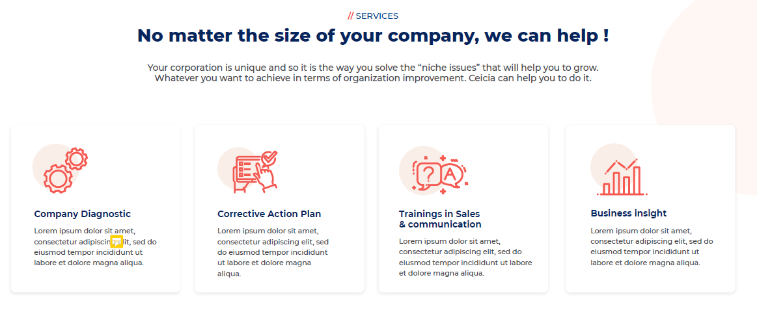
Company diagnostic
Understand the challenges encountered within your company and analyze their repercussions and solutions.
// Think Harmony
Ceicia makes it possible
An harmonized ecosystem will bring the utmost to your organization.
Business success goes with the emphasis of the human factor.
Give your teams the freedom to feel involved.
Corrective action plan
Adopt a « long-term temporary concept » bringing the strength of action towards trust, belonging and appreciation.
Support and implementation of solutions
Make your clients and partners involved in a constructive cooperative process.
Results & insights
Increase your efficiency, productivity and performance for direct positive impact on your income, employees and customers.
www.ceicia.com // 17

Slide 18










// Ceicia
More than a name, a state of mind,
Re-think the way you’re doing business to keep your talents, and customers delighted.
1. What?
Bring wholesomeness to your business.
2. How?
By identifying challenges through a company diagnostic and activate a corrective action plan.
3. Why?
Improve the « employees-managers » approach to boost people’s happiness, & reach your objectives in a more sustainable way.
Ceicia’s Founder
www.ceicia.com // 18

Slide 19
Everything that makes us human and not a robot. Having compassion, being creative and understanding.
// Our Values
When passion brings new perspectives
« Power without love is reckless and abusive, and love without power is sentimental and anemic. »
Martin Luther King Jr.
Humanity
Synergy
Fairness & Honesty
Go beyond
Bring the best out of the projects by enhancing teamwork. Create a real harmony for a result higher than your expectation.
Two essential values for the success of your company. Playing by the rules and be transparent is the basis of every cooperation. Standing up for the right of everyone to be treated equally and honestly.
The only limit is our mind. Go beyond with your team to create a sustainable future, meaningful missions and show appreciation.
www.ceicia.com // 19

Slide 20

Cécile Lammer
Founder & CEO
Cecile.lammer@ceicia.com

Slide 21
THANK YOU

